Slide 1
Computer Arch. & AI Chip and Systems Lecture 16: Overview
Prof. Zeke Wang
Zhejiang University
9 June 2025

Slide 2
Position of Systems
Application
System (TensorFlow) &
Hardware (AI Chip)
Notes:
One more tip: which company earn the most money from the AI surge? Nvidia.

Slide 3
Directly Talk About AI Chip and System?
No, most of you do not take computer architecture course!
Our course also includes computer architecture!
Notes:
The majority of you will not work on Systems.
But you should know the key principles that help you understand the system on which your AI task runs.
Our course has to include both computer architecture and AI chip courses.

Slide 4
Why Do We Have Computers?

Slide 5
Answer
To Solve Problems

Slide 6
How Does a Computer Solve Problems?

Slide 7
Answer
Orchestrating Electrons
In today’s dominant technologies

Slide 8
How Do Problems Get Solved by Electrons?

Slide 9
The Transformation Hierarchy
Problem
Algorithm
Program/Language
System Software
Computer Architecture (expanded view)
SW/HW Interface
Computer Architecture (narrow view)
Micro-architecture
Logic
Devices
Electrons

Slide 10
Axiom
To achieve the highest energy efficiency and performance:
we must take the expanded view
of computer architecture
Problem
Algorithm
Co-design across the hierarchy:
Algorithms to devices
Program/Language
System Software
SW/HW Interface
Specialize as much as possible
within the design goals
Micro-architecture
Logic
Devices
Electrons

Slide 11
Why AI Systems?
1, 卡脖子问题
2, More Design Space Exploration: Algorithm & Systems.

Slide 12
Topics of Computer Arch. and AI Chip

Slide 13
Things Every Programmer Should know
Amdhal Law
A formula which gives the theoretical speedup in latency of the execution of a task at fixed workload that can be expected of a system whose resources are improved.
Roofline Model
Theoretical performance bound of your application running on your machine.
Little’s Law: L = λ *W (buffer size = throughput * latency)
A theorem by John Little which states that the long-term average number L of customers in a stationary system is equal to the long-term average effective arrival rate λ multiplied by the average time W that a customer spends in the system.

Slide 14
Amdahl’s Law
Amdahl’s Law
f: Parallelizable fraction of a program
N: Number of processors
Serial bottleneck of Amdahl’s Law:
Maximum speedup (1/(1-f)) limited by serial portion (1 - f)
Parallel portion (f) is usually not perfectly parallel
Synchronization overhead (e.g., updates to shared data)
Load imbalance overhead (imperfect parallelization)
Resource sharing overhead (contention among N processors)
1
Speedup =
1 - f
+
f
N
Amdahl, “Validity of the single processor approach to achieving large scale computing capabilities,” 1967.

Slide 15
Things Every Programmer Should know
Amdhal Law
A formula which gives the theoretical speedup in latency of the execution of a task at fixed workload that can be expected of a system whose resources are improved.
Roofline Model
Theoretical performance bound of your application running on your machine.
Little’s Law: L = λ *W (buffer size = throughput * latency)
A theorem by John Little which states that the long-term average number L of customers in a stationary system is equal to the long-term average effective arrival rate λ multiplied by the average time W that a customer spends in the system.

Slide 16
Why Roofline Model
Why Roofline Model?
1, computing regime: Latency-limited → throughput-limited
Original latency-oriented performance model does not work
2, Target processor’s perspective
Showing inherent hardware limitations (or bound), in term of compute and memory
3, Compute kernel’s perspective
Showing the priority of optimizations for a given compute kernel running on a given processor
9
Williams, Waterman, Patterson, “Roofline: An Insightful Visual Performance Model for Multicore Architectures”, CACM, 2009
Notes:
All these works rely on many different methodology's to identify memory bottlenecks in a system. Often, such methodologies are intuitively used as a indication of NDP suitability for a given application
[CLICK] However, as I will show next, none of those models are comprehensive enough to identify memory bottlenecks and NDP suitability. This happens because these models are built targeting to identify specific sources of data movement bottlenecks, and often their definitions of compute and memory bound are not enough to indicate NDP suitability.
[CLICK] For that, we will analyze two commonly used approaches: the roofline model, which correlates the arithmetic intensity of an application with performance,
[CLICK] and identifying application that has high misses-per-kilo instructions or MPKI.
[NEXT]

Slide 17
Key Term in Roofline Model
Arithmetic intensity (AI)
Definition: AI = Total Flops / Total Memory Bytes
Arithmetic intensity describes the characteristics of a compute kernel running on a given processor
Large AI → Compute-bound
Small AI → Memory-bound
9
Williams, Waterman, Patterson, “Roofline: An Insightful Visual Performance Model for Multicore Architectures”, CACM, 2009
Notes:
All these works rely on many different methodology's to identify memory bottlenecks in a system. Often, such methodologies are intuitively used as a indication of NDP suitability for a given application
[CLICK] However, as I will show next, none of those models are comprehensive enough to identify memory bottlenecks and NDP suitability. This happens because these models are built targeting to identify specific sources of data movement bottlenecks, and often their definitions of compute and memory bound are not enough to indicate NDP suitability.
[CLICK] For that, we will analyze two commonly used approaches: the roofline model, which correlates the arithmetic intensity of an application with performance,
[CLICK] and identifying application that has high misses-per-kilo instructions or MPKI.
[NEXT]

Slide 18
Roofline Model’s Roof
Roofline model’s Roofline:
Application execution monitoring: arithmetic intensity;
Machine characterization: memory bandwidth, peak compute;
Peak Flop/s
Throughput (Flop/s)
DRAM GB/s
Arithmetic Intensity (Flop:Byte)
9
Williams, Waterman, Patterson, “Roofline: An Insightful Visual Performance Model for Multicore Architectures”, CACM, 2009
Notes:
All these works rely on many different methodology's to identify memory bottlenecks in a system. Often, such methodologies are intuitively used as a indication of NDP suitability for a given application
[CLICK] However, as I will show next, none of those models are comprehensive enough to identify memory bottlenecks and NDP suitability. This happens because these models are built targeting to identify specific sources of data movement bottlenecks, and often their definitions of compute and memory bound are not enough to indicate NDP suitability.
[CLICK] For that, we will analyze two commonly used approaches: the roofline model, which correlates the arithmetic intensity of an application with performance,
[CLICK] and identifying application that has high misses-per-kilo instructions or MPKI.
[NEXT]

Slide 19
How to Compute Roofline
Roofline model indicates the performance of an application is bounded by compute or memory
Attainable Flop/s = min( peak Flop/s, AI * peak GB/s )
Peak Flop/s
Throughput (Flop/s)
DRAM GB/s
Memory-bound
Compute-bound
Arithmetic Intensity (Flop:Byte)
9
Notes:
All these works rely on many different methodology's to identify memory bottlenecks in a system. Often, such methodologies are intuitively used as a indication of NDP suitability for a given application
[CLICK] However, as I will show next, none of those models are comprehensive enough to identify memory bottlenecks and NDP suitability. This happens because these models are built targeting to identify specific sources of data movement bottlenecks, and often their definitions of compute and memory bound are not enough to indicate NDP suitability.
[CLICK] For that, we will analyze two commonly used approaches: the roofline model, which correlates the arithmetic intensity of an application with performance,
[CLICK] and identifying application that has high misses-per-kilo instructions or MPKI.
[NEXT]

Slide 20
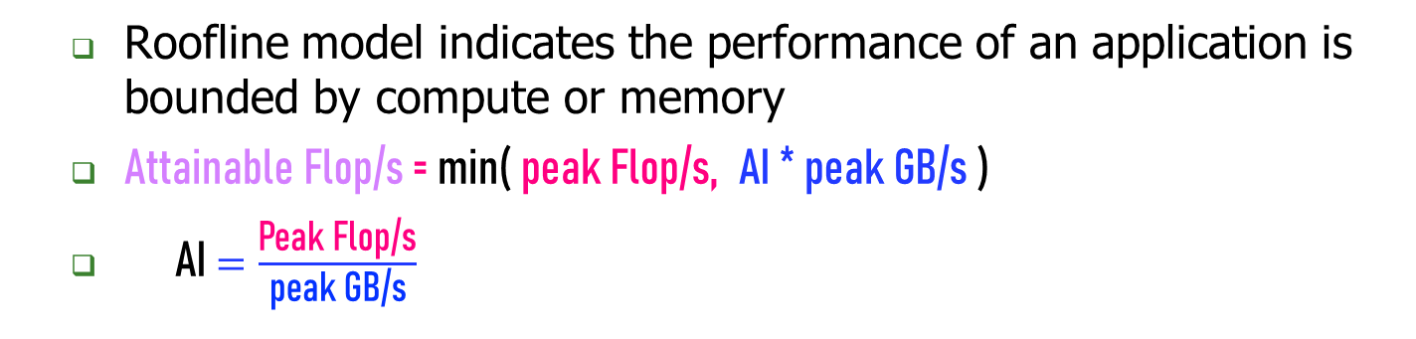
How to Compute Roofline
Roofline model indicates the performance of an application is bounded by compute or memory
Attainable Flop/s = min( peak Flop/s, AI * peak GB/s )
AI $=\frac{\text{Peak} \text{Flop}\text{/}\text{s}}{\text{peak} \text{GB}\text{/}\text{s}}$
Peak Flop/s
Throughput (Flop/s)
DRAM GB/s
Memory-bound
Compute-bound
Arithmetic Intensity (Flop:Byte)
9
Notes:
All these works rely on many different methodology's to identify memory bottlenecks in a system. Often, such methodologies are intuitively used as a indication of NDP suitability for a given application
[CLICK] However, as I will show next, none of those models are comprehensive enough to identify memory bottlenecks and NDP suitability. This happens because these models are built targeting to identify specific sources of data movement bottlenecks, and often their definitions of compute and memory bound are not enough to indicate NDP suitability.
[CLICK] For that, we will analyze two commonly used approaches: the roofline model, which correlates the arithmetic intensity of an application with performance,
[CLICK] and identifying application that has high misses-per-kilo instructions or MPKI.
[NEXT]

Slide 21
Compute Roofline Model
Compute roofline model:
No vectorization: none
Vec: vectorization code
Peak Flop/s: fused multiply-add + vectorization code
Peak Flop/s
Vec
Throughput (Flop/s)
DRAM GB/s
No vectorization
Arithmetic Intensity (Flop:Byte)
9
Notes:
All these works rely on many different methodology's to identify memory bottlenecks in a system. Often, such methodologies are intuitively used as a indication of NDP suitability for a given application
[CLICK] However, as I will show next, none of those models are comprehensive enough to identify memory bottlenecks and NDP suitability. This happens because these models are built targeting to identify specific sources of data movement bottlenecks, and often their definitions of compute and memory bound are not enough to indicate NDP suitability.
[CLICK] For that, we will analyze two commonly used approaches: the roofline model, which correlates the arithmetic intensity of an application with performance,
[CLICK] and identifying application that has high misses-per-kilo instructions or MPKI.
[NEXT]

Slide 22
Memory Roofline Model
Memory Roofline Model:
DRAM: limited memory bandwidth;
HBM: medium memory bandwidth;
Cache: large memory bandwidth
Peak Flop/s
HBM GB/s
Cache GB/s
Throughput (Flop/s)
DRAM GB/s
Arithmetic Intensity (Flop:Byte)
9
Williams, Waterman, Patterson, “Roofline: An Insightful Visual Performance Model for Multicore Architectures”, CACM, 2009
Notes:
All these works rely on many different methodology's to identify memory bottlenecks in a system. Often, such methodologies are intuitively used as a indication of NDP suitability for a given application
[CLICK] However, as I will show next, none of those models are comprehensive enough to identify memory bottlenecks and NDP suitability. This happens because these models are built targeting to identify specific sources of data movement bottlenecks, and often their definitions of compute and memory bound are not enough to indicate NDP suitability.
[CLICK] For that, we will analyze two commonly used approaches: the roofline model, which correlates the arithmetic intensity of an application with performance,
[CLICK] and identifying application that has high misses-per-kilo instructions or MPKI.
[NEXT]

Slide 23
Roofline Model: Examples
#pragma omp parallel for
for(i=0;i<N;i++){
Z[i] = X[i] + alpha*Y[i];
}
#pragma omp parallel for
for(k=1;k<dim+1;k++){
for(j=1;j<dim+1;j++){
for(i=1;i<dim+1;i++){
int ijk = i + j*jStride + k*kStride;
new[ijk] = -6.0*old[ijk ]
+ old[ijk-1 ]
+ old[ijk+1 ]
+ old[ijk-jStride]
+ old[ijk+jStride]
+ old[ijk-kStride]
+ old[ijk+kStride];
}}}
STREAM Triad:
Type: double
Memory: 24 Bytes/iteration
Compute: 2 flops/iteration
Arithmetic Intensity: 0.083 flops/byte
7-point constant coefficient stencil :
Type: short
Memory: 16 Bytes/iteration
Compute: 7 flops/iteration
Arithmetic Intensity: 0.4375 flops/byte
9
Williams, Waterman, Patterson, “Roofline: An Insightful Visual Performance Model for Multicore Architectures”, CACM, 2009
Notes:
All these works rely on many different methodology's to identify memory bottlenecks in a system. Often, such methodologies are intuitively used as a indication of NDP suitability for a given application
[CLICK] However, as I will show next, none of those models are comprehensive enough to identify memory bottlenecks and NDP suitability. This happens because these models are built targeting to identify specific sources of data movement bottlenecks, and often their definitions of compute and memory bound are not enough to indicate NDP suitability.
[CLICK] For that, we will analyze two commonly used approaches: the roofline model, which correlates the arithmetic intensity of an application with performance,
[CLICK] and identifying application that has high misses-per-kilo instructions or MPKI.
[NEXT]

Slide 24
Roofline Model: Examples
Peak Flop/s
Gflop/s ≤ AI * DRAM GB/s
Attainable Flop/s
DRAM GB/s
7-point
Stencil
TRIAD
0.083
0.44
Arithmetic Intensity (Flop:Byte)
9
Williams, Waterman, Patterson, “Roofline: An Insightful Visual Performance Model for Multicore Architectures”, CACM, 2009

Slide 25
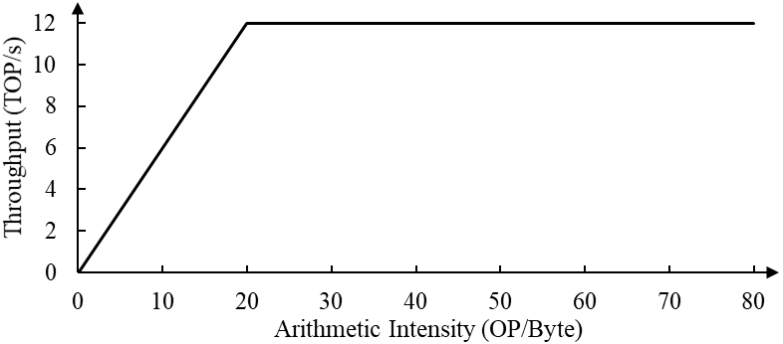
You’re required to evaluate the performance of three operators (Conv, FC and Attention) on an AI processor.
The chip manufacturer provides an empty roofline chart as below:
Performance benchmark results of the three operators are given as follow:
The operator Conv has 10000 operations (OPs) per 1000-byte memory access and achieves 5.8 TOP/s on the AI processor.
The operator FC has 30000 operations (OPs) per 1000-byte memory access and achieves 7.9 TOP/s on the AI processor.
The operator Attention has 50000 operations (OPs) per 1000-byte memory access and achieves 6.1 TOP/s on the AI processor.
(a) Please calculate theoretical computing throughput and memory bandwidth of the processor.
(b) Please place each operator onto the roofline chart given above.
(c) Among the three operators, which operators are almost fully optimized and which are not? Please give the reason.
(d) Which operators are memory-bound and which are compute-bound? Please give the reason.
(e) If there exists another implementation of the Conv operator where computing units finish convolution in fewer clock cycles, will its throughput become higher or not? Please give the reason.
9

Slide 26
OpenAI: Compute Power Needed by NN Model
Model | Model Size | Compute/iteration (OPs)
VGG 19 | 114M | ~19.6 B
“GPT-3” | 175B | ~250 T
One Forward Pass of Model:
Notes:
KB MB GB TB
K M B T
1B=10亿

Slide 27
OpenAI: Compute Needed by Whole Pre-training Model
Model | Model Size | Compute (Petaflop/s-days) | Compute (OPs)
GPT-3 Small | 125M | ~3 | ~3*10^20
GPT-3 2.7B | 2.7B | ~80 | ~8*10^21
“GPT-3” | 175B | ~3100 | ~3.1*10^23
Brown, Language Models are Few-Shot Learners, 2020
Notes:
KB MB GB TB
K M B T E P
1B=10亿

Slide 28
State-of-the-art CPU GPU and FPGA
 | Cores (Threads) | TFLOPS | Memory Size (Bandwidth) | PCIe | Network
CPU (AMD Threadripper 3995WX) | 64 (128) | 2.8 (FP32), 1.4 (FP64) | 512GB (80GB/s) | 32.0GB/s (PCIe 4.0 X16) | No
GPU (Nvidia A100) | 8192 (128K) | 19.5 (FP32), 9.7 (FP64), 156 (FP32, Tensor), 312 (FP16, Tensor) | 40/80GB (1935GB/s) | 32.0GB/s (PCIe 4.0 X16) | No
FPGA (U280) | 9,024 (25x18 MULs) | 1.8 (FP32) | 40GB (460GB/s) | 16.0GB/s (PCIe 4.0 X8) | Yes
Brown, Language Models are Few-Shot Learners, 2020
Notes:
KB MB GB TB
K M B T E P
1B=10亿

Slide 29
Things Every Programmer Should know
Amdhal Law
A formula which gives the theoretical speedup in latency of the execution of a task at fixed workload that can be expected of a system whose resources are improved.
Roofline Model
Theoretical performance bound of your application running on your machine.
Little’s Law: L = λ *W (buffer size = throughput * latency)
A theorem by John Little which states that the long-term average number L of customers in a stationary system is equal to the long-term average effective arrival rate λ multiplied by the average time W that a customer spends in the system.

Slide 30

Little’s Law：Intuition
Average service time: 6 mins
Arrival rate: one person/min
How many counters?
Image the services provided by counters in the bank.
Arrival rate: one customer/min;
Counter’s average serve time: 6 mins;
Question: how many counters are needed for people who need the service? (Cond: The customer will leave if no counter is available. )
Answer: 6 counters (one slot for one person, then no customer will leave).
Notes:
这里server不太合理

Slide 31
Little’s Law Used in Memory Subsystem
Latency: ~100ns
Buffer
Memory
Throughput: 12GB/s
Little’s law is widely used in hardware design whose latency is larger than one cycle, e.g., memory subsystem:
Throughput: 12GB/s;
Latency: 100ns;
Buffer Size (concurrency): 100ns * 12GB/s = 120B
Concurrency = Latency * Throughput

Slide 32
Where Are We?

Slide 33
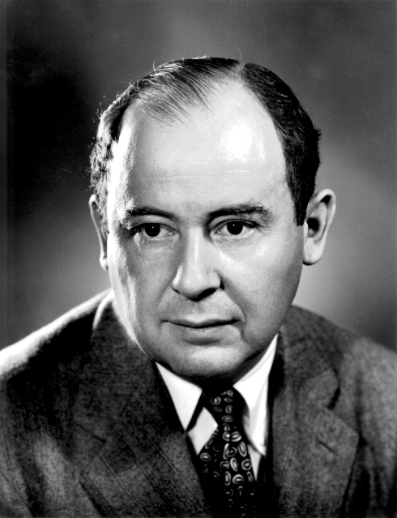
The von Neumann Model
In order to build a computer, we need an execution model for processing computer programs
John von Neumann proposed a fundamental model in 1946
von Neumann Model consists of 5 components
Memory (stores the program and data)
Processing unit
Input
Output
Control unit (controls the order in which instructions are carried out)
Throughout this lecture, we will examine one example of the von Neumann model
MIPS
Burks, Goldstein, von Neumann,
“Preliminary discussion of the logical design
of an electronic computing instrument,” 1946.

Slide 34
von Neumann Model: Two Key Properties
Von Neumann model is also called stored program computer (instructions in memory). It has two key properties:
Stored program
Instructions stored in a linear memory array
Memory is unified between instructions and data
The interpretation of a stored value depends on the control signals
Sequential instruction processing
One instruction processed (fetched, executed, completed) at a time
Program counter (instruction pointer) identifies the current instruction
Program counter is advanced sequentially except for control transfer instructions
Notes:
Every application can be descripted by this complete design von Neumann

Slide 35
Where Are We?

Slide 36
A Single-Cycle Microarchitecture A Closer Look

Slide 37
Single-cycle Machine
AS’
AS
Sequential
Logic
(State)
Combinational
Logic
AS: Architectural State

Slide 38
A Very Basic Instruction Processing Engine
Each instruction takes a single clock cycle to execute.
Only combinational logic is used to implement instruction execution.
No intermediate, programmer-invisible state updates
AS = Architectural (programmer visible) state
at the beginning of a clock cycle
Process instruction in one clock cycle
AS’ = Architectural (programmer visible) state
at the end of a clock cycle

Slide 39
Multi-Cycle Microarchitectures

Slide 40
Where Are We?

Slide 41
Multi-Cycle Microarchitectures
Goal: Let each instruction take (close to) only as much time it really needs
Idea of multi-cycle CPU:
Decrease clock cycle time
Each instruction takes as many clock cycles as it needs to take
Multiple state transitions per instruction
The states followed by each instruction is different

Slide 42
The “Process Instruction” Step of Multi-Cycle CPU
ISA specifies abstractly what AS’ should be, given an instruction and AS
It defines an abstract finite state machine where
State = programmer-visible state
Next-state logic = instruction execution specification
From ISA point of view, there are no “intermediate states” between AS and AS’ during instruction execution
One state transition per instruction
Microarchitecture implements how AS is transformed to AS’
We can have programmer-invisible state to optimize the speed of instruction execution: multiple state transitions per instruction
Single-cycle: AS → AS’ (transform AS to AS’ in a single clock cycle)
Multi-cycle: AS → AS+MS1 → AS+MS2 → AS+MS3 → AS’ (take multiple clock cycles to transform AS to AS’)

Slide 43
Multi-Cycle Microarchitecture
AS = Architectural (programmer visible) state
at the beginning of an instruction
Step 1: Process part of instruction in one clock cycle
Step 2: Process part of instruction in the next clock cycle
…
AS’ = Architectural (programmer visible) state
at the end of a clock cycle

Slide 44
Where Are We?

Slide 45
Can We Use the Idle Hardware to Improve Concurrency?
Goal: More concurrency → Higher instruction throughput (i.e., more “work” completed in one cycle)
Key Idea: When an instruction is using some resources in its processing phase, process other instructions on idle resources not needed by that instruction
E.g., when an instruction is being decoded, fetch the next instruction
E.g., when an instruction is being executed, decode another instruction
E.g., when an instruction is accessing data memory (ld/st), execute the next instruction
E.g., when an instruction is writing its result into the register file, access data memory for the next instruction

Slide 46
Pipelining: Basic Idea
More systematically:
Pipeline the execution of multiple instructions
Analogy: “Assembly line processing” of instructions
Idea of pipelining:
Divide the instruction processing cycle into distinct “stages” of processing
Ensure enough hardware resources to process one instruction in each stage
Process a different instruction in each stage
Instructions consecutive in program order are processed in consecutive stages
Benefit: Increases instruction processing throughput (1/CPI)

Slide 47
Example: Execution of Four Independent ADDs
Multi-cycle: 4 cycles per instruction
Pipelined: 4 cycles per 4 instructions (steady state)
F
D
E
W
F
D
E
W
F
D
E
W
F
D
E
W
Time
1 instruction completed per cycle
F
D
E
W
F
D
E
W
F
D
E
W
F
D
E
W
Time
Notes:
No, multi-cycle execution, unpredictable memory access cycles

Slide 48
Data Dependences
Types of data dependences
Flow dependence (read after write – true data dependence)
Output dependence (write after write)
Anti dependence (write after read)
Which ones cause stalls in a pipelined machine?
Our goal: we need to ensure semantics of the program is correct.
Flow dependences always need to be obeyed because they constitute true dependence on a register
Anti and output dependences exist due to limited number of architectural registers.
Essentially, insns are dependent on a name, not a value.

Slide 49
Data Dependence Types
Flow dependence
r₃ ← r₁ op r₂ Read-after-Write
r₅ ← r₃ op r₄ (RAW)
Anti dependence
r₃ ← r₁ op r₂ Write-after-Read
r₁ ← r₄ op r₅ (WAR)
Output-dependence
r₃ ← r₁ op r₂ Write-after-Write
r₅ ← r₃ op r₄ (WAW)
r₃ ← r₆ op r₇

Slide 50
Reorder Buffer: For False Dependencies
Output and anti dependences are not true dependences
WHY? The same register refers to values that have nothing to do with each other
They exist due to lack of register ID’s (i.e. names) in the ISA
This eliminates anti and output dependences
Gives the illusion that there are a large number of registers
HOW: The register ID is renamed to the reorder buffer entry that will hold the register’s value
Register ID → ROB entry ID
Architectural register ID → Physical register ID
After renaming, ROB entry ID used to refer to the register

Slide 51
Reorder Buffer: For False Dependencies
Flow dependence
r₃ ← r₁ op r₂ Read-after-Write
r₅ ← r₃ op r₄ (RAW)
Anti dependence
r₃ ← r₁ op r₂ Write-after-Read
r₁ ← r₄ op r₅ (WAR)
Output-dependence
r₃ ← r₁ op r₂ Write-after-Write
r₅ ← r₃ op r₄ (WAW)
r₃ ← r₆ op r₇
RB₁₀₀
RB₁₀₀
RB₁₀₁
RB₁₀₂

Slide 52
In-Order Pipeline with Reorder Buffer
Decode (D): Access regfile/ROB, allocate entry in ROB, check if instruction can execute, if so dispatch instruction
Execute (E): Instructions can complete out-of-order
Completion (R): Write result to reorder buffer
Retirement/Commit (W): Check for exceptions; if none, write result to architectural register file or memory; else, flush pipeline and start from exception handler
In-order dispatch/execution, out-of-order completion, in-order retirement
E
Integer add
Integer mul
E
E
E
E
R
W
F
D
FP mul
E
E
E
E
E
E
E
E
R
. . .
E
E
E
E
E
E
E
E
Load/store

Slide 53
Where Are We?

Slide 54
Recall: Data Dependence Types
Flow dependence
r₃ ← r₁ op r₂ Read-after-Write
r₅ ← r₃ op r₄ (RAW)
Anti dependence
r₃ ← r₁ op r₂ Write-after-Read
r₁ ← r₄ op r₅ (WAR)
Output-dependence
r₃ ← r₁ op r₂ Write-after-Write
r₅ ← r₃ op r₄ (WAW)
r₃ ← r₆ op r₇

Slide 55
How Can We Do Better?
What do the following two pieces of code have in common (with respect to execution in the previous design)?
Answer: First ADD stalls the whole pipeline!
ADD cannot dispatch because its source registers unavailable
Later independent instructions cannot get executed
How are the above code portions different?
Answer: Load latency is variable (unknown until runtime)
IMUL R3 ← R1, R2
ADD R3 ← R3, R1
ADD R4 ← R6, R7
IMUL R5 ← R6, R8
ADD R7 ← R9, R9
LD R3 ← R1 (0)
ADD R3 ← R3, R1
ADD R4 ← R6, R7
IMUL R5 ← R6, R8
ADD R7 ← R9, R9

Slide 56
Preventing Dispatch Stalls
Problem: in-order dispatch (scheduling, or execution)
Solution: out-of-order dispatch (scheduling, or execution)
Goal of out-of-order dispatch:
Like Dataflow, “fire” an instruction only when its inputs are ready
LD R3 ← R1 (0)
ADD R3 ← R3, R1
ADD R4 ← R6, R7
IMUL R5 ← R6, R8
ADD R7 ← R9, R9
The insn “ADD R3…” will not impede insns “ADD R4…, IMUL R5…, ADD R7…”.

Slide 57
Out-of-order Execution (Dynamic Scheduling)
Idea: Move the dependent instructions out of the way of independent ones (s.t. independent ones can execute)
Rest areas for dependent instructions: Reservation stations
Monitor the source “values” of each instruction in the resting area
When all source “values” of an instruction are available, “fire” (i.e. dispatch) the instruction
Instructions dispatched in dataflow (not control-flow) order
Benefit:
Latency tolerance: Allows independent instructions to execute and complete in the presence of a long-latency operation
Notes:
One road with multiple ways…

Slide 58
Tomasulo’s Algorithm for OoO Execution
OoO with register renaming invented by Robert Tomasulo
Used in IBM 360/91 Floating Point Units
Read: Tomasulo, “An Efficient Algorithm for Exploiting Multiple Arithmetic Units,” IBM Journal of R&D, Jan. 1967.
OoO variants are used in most high-performance processors
Initially in Intel Pentium Pro, AMD K5
Alpha 21264, MIPS R10000, IBM POWER5, IBM z196, Oracle UltraSPARC T4, ARM Cortex A15, Apple M1, …
Notes:
360 is not commercially suceesful, without precious exception

Slide 59
Two Humps in a Modern Pipeline
Hump 1: Reservation station (scheduling window)
Hump 2: Reorder Buffer ( aka instruction window or active window)
TAG and VALUE Broadcast Bus
S
C
H
E
D
U
L
E
R
E
O
R
D
E
R
E
Integer add
Integer mul
F
D
E
E
E
E
W
FP mul
E
E
E
E
E
E
E
E
. . .
E
E
E
E
E
E
E
E
Load/store
in order
out of order
in order

Slide 60
In-order vs. Out-of-order Dispatch
In order dispatch + precise exceptions:
Out-of-order dispatch + precise exceptions:
IMUL R3 ← R1, R2
ADD R3 ← R3, R1
ADD R1 ← R6, R7
IMUL R5 ← R6, R8
ADD R7 ← R3, R5
F
D
E
E
E
E
R
W
F
D
STALL
E
R
W
F
STALL
D
E
R
W
F
D
E
E
E
E
E
R
W
16 cycles
F
D
STALL
E
R
W
F
D
E
E
E
E
R
W
F
D
WAIT
E
R
W
12 cycles
F
D
E
R
W
F
D
E
E
E
E
R
W
F
D
WAIT
E
R
W

Slide 61
This problem deals with a processor with out-of-order dispatch and precise exception with 1 adder and 1 multiplier. The adder has a two-cycle latency and is fully pipelined, while the multiplier has a four-cycle latency and is fully pipelined. Consider the following instruction sequence:
I₁ ADD $s3, $s1, $s2
I₂ IMUL $s4, $s1, $s3
I₃ IMUL $s1, $s3, $s4
I₄ ADD $s4, $s5, $s3
I₅ IMUL $s6, $s4, $s5
[2 points] Give an example of write-after-write (WAW) hazard from the instruction sequence. What’s the solution to this hazard?
Draw a dataflow graph for the instruction sequence. An example is given as follows.
MUL $s3, $s1, $s2
ADD $s5, $s3, $s4
$s1
$s2
×
$s4
$s3
+
$s5

Slide 62
Please draw your own graph below.
Simulate the instruction execution procedure. Complete the state of each instruction at each cycle in the following table. Use F, D, E, R and W to represent IF, ID, EXE, reorder buffer and WB stage. Use “－” to represent waiting state. You are not required to use all columns in the table.
(d) Given a processor with in-order dispatch without reorder buffer, while instruction sequence and computing units keep the same, how many cycles does the in-order processor take to finish the procedure? Please give your analysis. Note that precise exception should still be guaranteed here.
Cycle | 1 | 2 | 3 | 4 | 5 | 6
I₁ | F | D | E | E | R | W
I₂ |  | F | D
I₃ |  |  | F | D
I₄ |  |  |  | F | D
I₅ |  |  |  |  | F | D
Cycle | 1 | 2 | 3 | 4 | 5 | 6
I₁
I₂
I₃
I₄
I₅

Slide 63
Performance Analysis
Execution time of a single instruction
{CPI} x {clock cycle time}
Execution time of an entire program
Sum over all instructions [{CPI} x {clock cycle time}]
{# of instructions} x {Average CPI} x {clock cycle time}
Single-cycle microarchitecture performance
CPI = 1
Clock cycle time = long
Multi-cycle microarchitecture performance
CPI = different for each instruction
Average CPI → hopefully small
Clock cycle time = short
CPI: Cycles Per Instruction

Slide 64
P is a multi-cycle processor with a clock cycle of 2ns. Under ideal conditions (with a hit rate of 100%), P executes a load instruction in 4 cycles, a store instruction in 6 cycles, an arithmetic instruction in 2 cycles, and a branch instruction in 3 cycles.
Let's consider an application called A with 20% of the instructions being load instructions, 10% being store instructions, 50% being arithmetic instructions, and 20% being branch instructions.
(a) What is the CPI when running application A on processor P under ideal conditions?
(b) P’s memory access time for a miss is 100ns, while the hit time is 1 clock cycle. The cache is direct-mapped cache, it has a miss rate of 1.4%. What is the average memory access time of P?
(c) each instruction of application A requires an average of 1.3 memory accesses, and A has 100 instructions. What is the CPU time of process P to run application A, taking into account cache misses?
(d) Replace the cache of P1 with a 2-way set-associative cache. It has a miss rate of 1.0%. Due to the existence of multi-way selection, the CPU clock cycle increases to 1.05 times of the original. Which caching method has faster execution time for application A?

Slide 65
Flynn’s Taxonomy of Computers
Mike Flynn, “Very High-Speed Computing Systems,” Proc. of IEEE, 1966
SISD: Single instruction operates on single data element
SIMD: Single instruction operates on multiple data elements
Array processor
Vector processor
MISD: Multiple instructions operate on single data element
Closest form: systolic array processor, streaming processor
MIMD: Multiple instructions operate on multiple data elements (multiple instruction streams)
Multiprocessor
Multithreaded processor
Notes:
Flynn:弗林

Slide 66
Intuition of SIMD Capability
计算任务 (A[6:0] + B[6:0])
Scalar: 一个周期完成一个加法
SIMD : 一个周期完成多个加法
t6
A[6]
B[6]
t5
A[5]
B[5]
t4
A[4]
B[4]
t3
A[3]
B[3]
t2
A[2]
B[2]
t1
A[1]
B[1]
t1
A[4]
B[4]
A[5]
B[5]
A[6]
B[6]
t0
A[0]
B[0]
t0
A[0]
B[0]
A[1]
B[1]
A[2]
B[2]
A[3]
B[3]
+
+
+
+
+
Scalar
SIMD

Slide 67
GPUs are SIMD Engines Underneath
The instruction pipeline operates like a SIMD pipeline (e.g., an array processor)
However, the programming is done using threads, NOT SIMD instructions
To understand this, let’s go back to our parallelizable code example
But, before that, let’s distinguish between
Programming Model (Software)
vs.
Execution Model (Hardware)

Slide 68
Programming Model vs. Hardware Execution Model
Programming Model： how the programmer expresses the code
E.g., Sequential (von Neumann), Data Parallel (SIMD), Dataflow, Multi-threaded (MIMD, SPMD), …
Hardware Execution Model： how the hardware executes the code underneath
E.g., Out-of-order execution, Vector processor, Array processor, Dataflow processor, Multiprocessor, Multithreaded processor, …
Execution Model can be very different from Programming Model
E.g., von Neumann model implemented by an OoO processor
E.g., SPMD model implemented by a SIMD processor (a GPU)

Slide 69
NVIDIA A100
NVIDIA-speak:
6912 stream processors
“SIMT execution”
Generic speak:
108 cores
64 SIMD functional units per core
Tensor cores for Machine Learning
Support for sparsity
New floating point data type (TF32)
https://developer.nvidia.com/blog/nvidia-ampere-architecture-in-depth/
Notes:
5 HBM2 stacks, 10 512-bit memory controllers
Sparsity is possible in deep learning because the importance of individual weights evolves during the learning process, and by the end of network training, only a subset of weights have acquired a meaningful purpose in determining the learned output. The remaining weights are no longer needed (see https://developer.nvidia.com/blog/nvidia-ampere-architecture-in-depth/).
TensorFloat-32 (TF32) uses 8 bit for exponent and 10 bits for mantissa. This way, TF32 provides the range of FP32 with the precision of FP16 (see https://developer.nvidia.com/blog/nvidia-ampere-architecture-in-depth/).

Slide 70
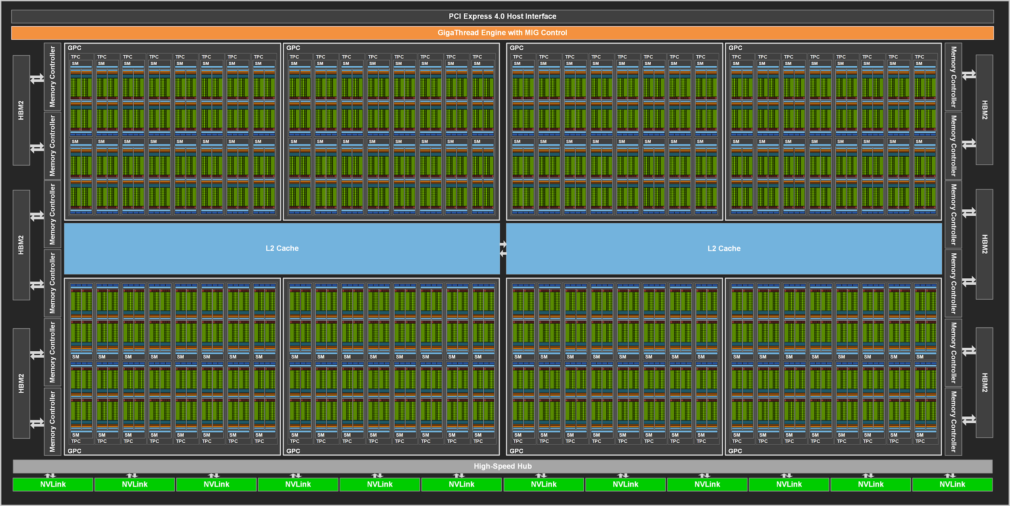
NVIDIA A100 Block Diagram
https://developer.nvidia.com/blog/nvidia-ampere-architecture-in-depth/
108 cores on the A100
(Up to 128 cores in the full-blown chip)
40MB L2 cache
Notes:
The A100 GPU includes 40 MB of L2 cache, which is 6.7x larger than V100 L2 cache.The L2 cache is divided into two partitions to enable higher bandwidth and lower latency memory access. Each L2 partition localizes and caches data for memory accesses from SMs in the GPCs directly connected to the partition. This structure enables A100 to deliver a 2.3x L2 bandwidth increase over V100 (see https://developer.nvidia.com/blog/nvidia-ampere-architecture-in-depth/).

Slide 71
A GPU is a SIMD (SIMT) Machine
Except it is not programmed using SIMD instructions
It is programmed using threads (SPMD programming model)
Each thread executes the same code but operates a different piece of data
Each thread has its own context (i.e., can be treated/restarted/executed independently)
A set of threads executing the same instruction are dynamically grouped into a warp (wavefront) by the hardware
A warp is essentially a SIMD operation formed by hardware!

Slide 72
Warp-based SIMD vs. Traditional SIMD
Traditional SIMD contains a single thread
Sequential instruction execution; lock-step operations in a SIMD instruction
Programming model is SIMD (no extra threads) → SW needs to know vector length
ISA contains vector/SIMD instructions
Warp-based SIMD consists of multiple scalar threads executing in a SIMD manner (i.e., same instruction executed by all threads)
Does not have to be lock step
Each thread can be treated individually (i.e., placed in a different warp) → programming model not SIMD
SW does not need to know vector length
Enables multithreading and flexible dynamic grouping of threads
ISA is scalar → SIMD operations can be formed dynamically
Essentially, it is SPMD programming model implemented on SIMD hardware

Slide 73
Control Flow Problem in GPUs/SIMT
A GPU uses a SIMD pipeline to save area on control logic
Groups scalar threads into warps
Branch divergence occurs when threads inside warps branch to different execution paths
Branch
Branch
Path A
Path A
Path B
Path B
This is the same as conditional/predicated/masked execution.
Slide credit: Tor Aamodt

Slide 74
Nvidia’s Success: Transparent Scalability
Hardware is free to schedule thread blocks
Gen 1
Gen 2
Device
Kernel grid
Block 0
Block 1
Device
Block 2
Block 3
time
Block 0
Block 1
Block 4
Block 5
Block 6
Block 7
time
Block 0
Block 1
Block 2
Block 3
Block 2
Block 3
Block 4
Block 5
Block 6
Block 7
Block 4
Block 5
Each block can execute in any order relative to other blocks.
Block 6
Block 7
The CUDA code stays the same and enjoys performance improvement while GPU hardware evolves.
Slide credit: Hwu & Kirk
Notes:
Thread block is the key innovation to scale-up GPU architecture. The software code stays the same and enjoys performance speedup while GPU hardware evolves.

Slide 75
Memory Is Very Important

Slide 76
Idealism
Pipeline
(Instruction
execution)
Instruction
Supply
Data
Supply
- Zero latency access
- Infinite capacity
- Zero cost
- Perfect control flow
No pipeline stalls
Perfect data flow
(reg/memory dependencies)
Zero-cycle interconnect
(operand communication)
Enough functional units
Zero latency compute
Zero latency access
Infinite capacity
- Infinite bandwidth
Zero cost

Slide 77
DRAM Capacity, Bandwidth & Latency
128x
20x
1.3x

Slide 78
FF vs. SRAM vs. DRAM vs. Others
Flip-Flops
Very fast, parallel access
Very expensive (one bit costs tens of transistors)
Static RAM
Relatively fast, only one data word at a time
Expensive (one bit costs 6+ transistors)
Dynamic RAM
Slower, one data word at a time, reading destroys content (refresh), needs special process for manufacturing
Cheap (one bit costs only one transistor plus one capacitor)
Other storage technology (flash memory, hard disk, tape)
Much slower, access takes a long time, non-volatile
Very cheap (one transistor stores 16 bits or no transistors involved)

Slide 79
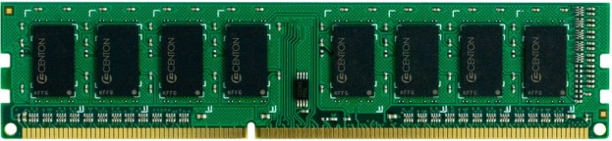

The DRAM Subsystem
“Channel”
DIMM (Dual in-line memory module)
Processor
Memory channel
Memory channel

Slide 80
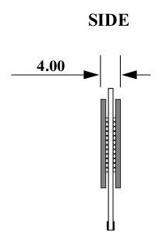
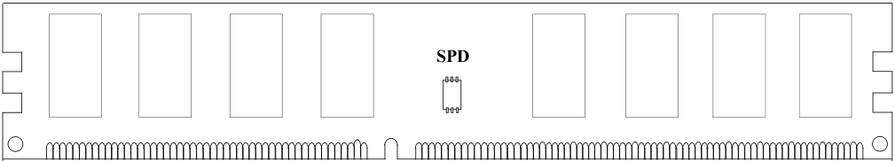
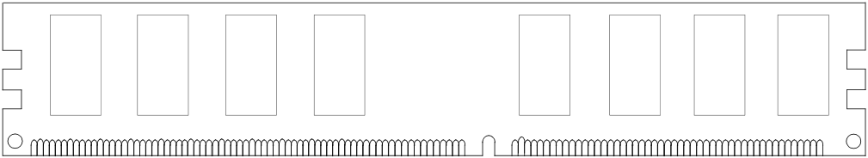
Breaking down a DIMM (module)
DIMM (Dual in-line memory module)
Side view
Front of DIMM
Back of DIMM

Slide 81
Breaking down a DIMM (module)
DIMM (Dual in-line memory module)
Side view
Front of DIMM
Back of DIMM
Rank 0: collection of 8 chips
Rank 1

Slide 82
Rank
Rank 0 (Front)
Rank 1 (Back)
<0:63>
<0:63>
Addr/Cmd
CS <0:1>
Data <0:63>
Memory channel

Slide 83
Breaking down a Rank
. . .
Chip 0
Chip 1
Chip 7
Rank 0
<0:63>
<0:7>
<8:15>
<56:63>
Data <0:63>

Slide 84
Breaking down a Chip
8 banks
Chip 0
Bank 0
<0:7>
<0:7>
<0:7>
...
<0:7>
<0:7>

Slide 85
Breaking down a Bank
2kB
1B (column)
row 32k-1
Bank 0
...
row 0
<0:7>
Row-buffer
1B
1B
1B
...
<0:7>

Slide 86
Three DRAM Access States
Page Hit:
Occurs when a memory transaction accesses a row that is open in its bank, so no Precharge and Activate commands are required before the column access, resulting in minimum latency.
Page Closed:
Occurs when a memory transaction accesses a row whose corresponding bank is closed, so the row Activate command is required before the column access.
Page Miss:
Occurs when a memory transaction accesses a row that does not match the active row in the bank, so one Precharge command and one Activate command are issued before the column access, resulting in maximum latency.

Slide 87
DRAM Refresh
DRAM capacitor charge leaks over time
The memory controller needs to refresh each row periodically to restore charge
Activate each row every N ms
Typical N = 64 ms
Downsides of refresh:
-- Energy consumption: Each refresh consumes energy
-- Performance degradation: DRAM rank/bank unavailable while refreshed
-- QoS/predictability impact: (Long) pause times during refresh
-- Refresh rate limits DRAM capacity scaling

Slide 88
Where Are We?

Slide 89
The Problem of Ideal Memory
Bigger is slower
SRAM, 512 Bytes, sub-nanosec
SRAM, KByte~MByte, ~nanosec
DRAM, Gigabyte, ~50 nanosec
PCM-DIMM (Intel Optane DC DIMM), Gigabyte, ~200 nanosec
PCM-SSD (Intel Optane SSD), Gigabyte, ~10 µs
Flash memory, Gigabyte~Terabyte, ~100 µs
Hard Disk, Terabyte, ~10 millisec
Faster is more expensive (dollars and chip area)
SRAM, < 0.3$ per Megabyte
DRAM, < 0.03$ per Megabyte
PCM-DIMM (Intel Optane DC DIMM), < 0.004$ per Megabyte
PCM-SSD, < 0.001$ per Megabyte
Flash memory, < 0.00008$ per Megabyte
Hard Disk, < 0.00003$ per Megabyte

Slide 90
Memory Hierarchy
Fundamental tradeoff
Fast memory: small
Large memory: slow
Idea: Memory hierarchy.
Latency, cost, size,
bandwidth
Hard Disk
Main
Memory
(DRAM)
CPU
Cache
RF

Slide 91
The Memory Hierarchy
move what you use here
fast
small
With good locality of reference, memory appears as fast as
and as large as
faster per byte
cheaper per byte
backup
everything
here
large but slow

Slide 92
Why Cache Works? Locality
Locality: One’s recent past is a very good predictor of his/her near future.
Temporal Locality: If you just did something, it is very likely that you will do the same thing again soon
since you are here today, there is a good chance you will be here again and again regularly
Spatial Locality: If you did something, it is very likely you will do something similar/related (in space)
every time I find you in this room, you are probably sitting close to the same people

Slide 93
Caching Basics: Exploit Temporal Locality
Idea: Store recently accessed data in automatically-managed fast memory (called cache)
Anticipation: same mem. location will be accessed again soon
Temporal locality principle
Recently accessed data will be again accessed in the near future
This is what Maurice Wilkes had in mind:
“The use is discussed of a fast core memory of, say 32000 words as a slave to a slower core memory of, say, one million words in such a way that in practical cases the effective access time is nearer that of the fast memory than that of the slow memory.”
Wilkes, “Slave Memories and Dynamic Storage Allocation,” IEEE Trans. On Electronic Computers, 1965.

Slide 94
Caching Basics: Exploit Spatial Locality
Idea: Store data in addresses adjacent to the recently accessed one in automatically-managed fast memory
Logically divide memory into equal-size blocks
Fetch to cache the accessed block in its entirety
Anticipation: nearby memory locations will be accessed soon
Spatial locality principle
Nearby data in memory will be accessed in the near future
E.g., sequential instruction access, array traversal
This is what IBM 360/85 implemented
16 Kbyte cache with 64 byte blocks
Liptay, “Structural aspects of the System/360 Model 85 II: the cache,” IBM Systems Journal, 1968.

Slide 95
Caching Basics
Cache Block (line): Unit of storage in the cache
Memory is logically divided into blocks that map to potential locations in the cache.
On a reference:
HIT: If in cache, use cached data instead of accessing memory
MISS: If not in cache, bring block into cache
May have to evict some other block
For high cache hit rate, important cache design decisions:
Placement: where and how to place/find a block in cache?
Replacement: what data to remove to make room in cache?
Granularity of management: large or small blocks? Subblocks?
Write policy: what do we do about writes?
Instructions/data: do we treat them separately?

Slide 96
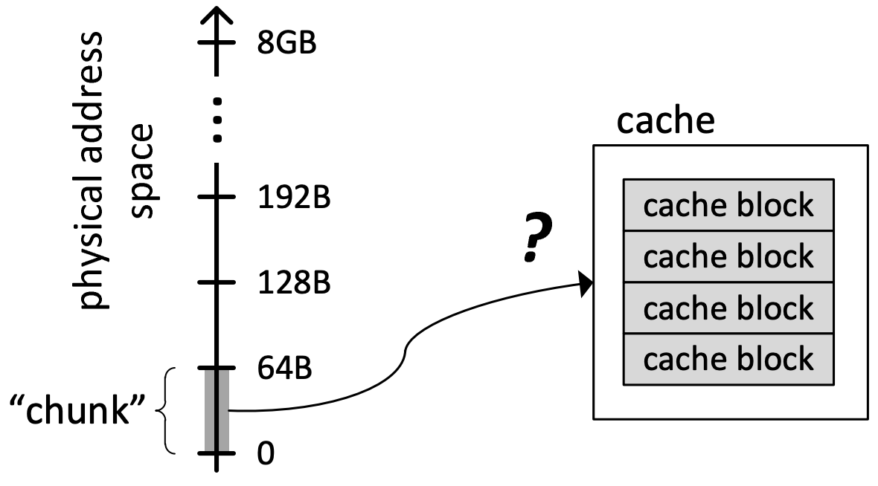
Cache: Placement
A key question: How to map chunks of the main memory address space to blocks in the cache?
Which location in cache can a given “main memory chunk” be placed in?

Slide 97
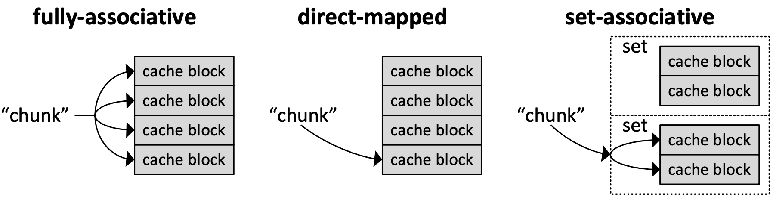
Three Cache Organization Methods
Direct-mapped:
A chunk can go to only one cache block in the cache. (Another extreme)
Fully-associative:
A chunk can go to any cache block in the cache. (One extreme)
Set-associative:
A chunk can go to N cache blocks in the N-way set-associative cache. (Best choice)
Kim & Mutlu, “Memory Systems,” Computing Handbook, 2014

Slide 98
2-way Set-Associative Cache: Structure
Set-Associative Cache
A block can be placed in any of N blocks of N-way set-associative cache
Example of 2-way cache:
Instead of having one column of 8, have 2 columns of 4 blocks
Tag store
Data store
2-way SET
V
tag
V
tag
=?
=?
MUX
Address:
Logic
MUX
tag
index
byte in block
byte in block
Hit?
3 bits
2 bits
3 bits

Slide 99
4-way Set Associativity
4-way
+ Likelihood of conflict misses even lower
-- More tag comparators and wider data mux; larger tags
Tag store
=?
=?
=?
=?
Logic
Hit?
Data store
MUX
MUX
byte in block
Address
tag
index
byte in block
4 bits
1 b
3 bits

Slide 100
Set-Associative Cache: Advantage and Issue
Set-Associative Cache
Key Idea: Associative memory within the set
Advantage of Set-Associative Cache
Accommodates conflicts better (fewer conflict misses)
Assume addresses A and B have the same index bits but different tag bits
A, B, A, B, A, B, A, B, … → store in the cache set
All accesses are cache hit
Issue of Set-Associative Cache
More complex, slower access, larger tag store

Slide 101
Caching Basics
Cache Block (line): Unit of storage in the cache
Memory is logically divided into blocks that map to potential locations in the cache.
On a reference:
HIT: If in cache, use cached data instead of accessing memory
MISS: If not in cache, bring block into cache
May have to evict some other block
For high cache hit rate, important cache design decisions:
Placement: where and how to place/find a block in cache?
Replacement: what data to remove to make room in cache?
Granularity of management: large or small blocks? Subblocks?
Write policy: what do we do about writes?
Instructions/data: do we treat them separately?

Slide 102
Replacement in Set-Associative Caches
Key Challenge:
Which cache block in a set be replaced once new block comes?

Slide 103
Cache Block Replacement Policy
Which block in the set to replace on a cache miss?
1, Any invalid block first
2, If all are valid, consult the replacement policy:
Random
FIFO
Least recently used (how to implement?)
Hybrid replacement policies
Optimal replacement policy?

Slide 104
Caching Basics
Cache Block (line): Unit of storage in the cache
Memory is logically divided into blocks that map to potential locations in the cache.
On a reference:
HIT: If in cache, use cached data instead of accessing memory
MISS: If not in cache, bring block into cache
May have to evict some other block
For high cache hit rate, important cache design decisions:
Placement: where and how to place/find a block in cache?
Replacement: what data to remove to make room in cache?
Granularity of management: large or small blocks? Subblocks?
Write policy: write-allocate, write-back/write-through
Instructions/data: do we treat them separately?

Slide 105
Cache Policies: Handling Memory Write
Where should you write the result of a store? One policy for each step.
Step 1: if not in cache, either policy works:
Write-allocate policy (default):
Allocate the cache line (put it in the cache).
Issue: Read an entire cache block from memory
Write-no-allocate policy (PCIe/IO):
Write it directly to memory without allocation in cache.
Ignore cache.
Step 2: if in the cache, either policy works:
Write-back policy (default):
writes it to the cache and wait until we kick the cache block out
Write-through policy (streaming write instruction):
Writes it to the cache and memory right away
Notes:
4 combinations…

Slide 106
Cache: Write-back vs. Write-through
Write-back:
Write goes to cache; cache writes to main memory (evicted)
+ Can combine multiple writes to the same block before eviction
Potentially saves bandwidth between cache levels + saves energy
-- Need a bit in the tag store indicating the block is “dirty/modified”
Write-through:
Write goes to memory and cache
+ Simpler
+ Evictions do not need to write to memory
+ All levels are up to date
Consistency: Simpler cache coherence because no need to check close-to-processor caches’ tag stores for presence
-- More memory bandwidth intensive; no combining of writes

Slide 107
Caching Basics
Cache Block (line): Unit of storage in the cache
Memory is logically divided into blocks that map to potential locations in the cache.
On a reference:
HIT: If in cache, use cached data instead of accessing memory
MISS: If not in cache, bring block into cache
May have to evict some other block
For high cache hit rate, important cache design decisions:
Placement: where and how to place/find a block in cache?
Replacement: what data to remove to make room in cache?
Granularity of management: large or small blocks? Subblocks?
Write policy: what do we do about writes?
Instructions/data: do we treat them separately?

Slide 108
Cache Terminology
Capacity (C):
the number of data bytes a cache stores
Block size (b):
bytes of data brought into cache at once
Number of blocks (B = C/b):
number of blocks in cache: B = C/b
Degree of associativity (N):
number of blocks in a set
Number of sets (S = B/N):
each memory address maps to exactly one cache set

Slide 109
Cache Organization Recap
Main Parameters
Capacity: C
Block size: b
Number of blocks in cache: B = C/b
Number of blocks in a set: N
Number of Sets: S = B/N
Organization | Number of Ways (N) | Number of Sets (S = B/N)
Direct Mapped | 1 | B
N-Way Set Associative | 1 < N < B | B / N
Fully Associative | B | 1
109

Slide 110
Memory Consistency vs. Cache Coherence
Coherence is about ordering of operations from different processors to the same memory location
Local ordering of accesses to each cache block
Consistency is about ordering of all memory operations from different processors (i.e., to different memory locations)
Global ordering of accesses to all memory locations
Notes:
Coherence;一致性
Consistency:连贯性

Slide 111
A computer system has a 32-byte cache, the size of each block is 4 bytes. The smallest addressable unit is 1 byte. Given the following access sequence S1 and the cache is empty at the beginning.
S1: 0x8, 0x28, 0x8, 0x88, 0x8, 0x28
(a) If the cache is direct mapped. Analyze whether each memory access is hit, if an access causes a cache miss, what kind of miss it is, compulsory miss, capacity miss, or conflict miss? And explain why.
(b) if the cache is 2-way set-associative (using LRU replacement strategy), analyze whether each memory access is hit, if an access causes a cache miss, what kind of miss it is, compulsory miss, capacity miss, or conflict miss? And explain why.
(c) If the cache is fully associative (using LRU replacement strategy), analyze whether each memory access is hit, if an access causes a cache miss, what kind of miss it is, compulsory miss, capacity miss, or conflict miss? And explain why.
(d) Comparing the hit rates of three caches under the given access sequence in the question, which cache mapping policy has the highest hit rate.

Slide 112
Cache Coherence

Slide 113
Hardware Architecture for Cache Coherence
Hardware architecture for Cache Coherence:
Cores, caches, interconnect, memory work together to achieve cache coherence from core’s point of view.
Interconnect: Snoop/Directory
Cache Updating: invl./update
Cache Tags: MESI
Core
Core
Core
CPU action
CPU action
Cache blocks
Tags
Cache blocks
Tags
Cache
Bus action
Bus action
Interconnection Network
Interconnect
R: read
W:write
I: invalidate
U: update
Main Memory
Memory

Slide 114
Cache Coherence Protocols
Cache Coherence
Snoop: [Goodman ISCA 1983]
Bus-based, each bus action broadcasts on the bus, one action at a time, each bus action broadcasts on the bus, one action at a time.
Single point of serialization for all memory requests.
Directory:[Censier, ToC 1978]
Single point of serialization per block, distributed among nodes
Cores make explicit requests for blocks
Directory tracks which caches have each block
Directory coordinates invalidation and updates
Core
Core
CPU action
CPU action
Cache blocks
Tags
Cache blocks
Tags
Dict.
Dict.
Bus action
Bus action
Switch (peer to peer)
Main Memory

Slide 115
Cache Coherence: Updating Policy
Cache Updating Policy: safely update replicated data in other caches.
Update Protocol:
Push a update command (bus action) to all copies
Invalidate Protocol:
Ensure only one local copy by sending out an invalidation command (bus action), then update the local copy
Core
Core
CPU action
CPU action
Cache blocks
Tags
Cache blocks
Tags
Dict.
Dict.
Bus action
Bus action
Interconnect network
Main Memory
Notes:
大三有很多课，假如10门课，你跟你室友都选了人工智能芯片与系统专业课，这样人工智能专业课的信息大家有兴趣去了解（update比较好）；但有选修课，不是所有人都选了，这个时候update就不好，invalidate就比较好。

Slide 116
Cache Coherence: Cache Tags
MSI Protocol: safely update replicated data in caches (goal).
I(nvalid): block is not in cache, need to fetch from memory or other cache
S(hared): in >=1 caches, clean, local cores can read it w/o bus action
M(odified): in 1 cache, core can read/write it w/o bus action
Core
Core
CPU action
CPU action
Cache blocks
Tags
Cache blocks
Tags
Bus action
Bus action
Bus (one trans. A time)
Main Memory
Notes:
大三有很多课，假如10门课，你跟你室友都选了人工智能芯片与系统专业课，这样人工智能专业课的信息大家有兴趣去了解（update比较好）；但有选修课，不是所有人都选了，这个时候update就不好，invalidate就比较好。

Slide 117
Cache Coherence: Cache Tags
MSI Protocol: safely update replicated data in caches (goal).
I(nvalid): block is not in cache, need to fetch from memory or other cache
S(hared): in >=1 caches, clean, local cores can read it w/o bus action
M(odified): in 1 cache, core can read/write it w/o bus action
Core
Core
CPU action
CPU action
Cache blocks
Tags
Cache blocks
Tags
Bus action
Bus action
Bus (one trans. A time)
Main Memory
Notes:
大三有很多课，假如10门课，你跟你室友都选了人工智能芯片与系统专业课，这样人工智能专业课的信息大家有兴趣去了解（update比较好）；但有选修课，不是所有人都选了，这个时候update就不好，invalidate就比较好。

Slide 118
The Problem with MSI
A block is not in cache at the beginning. On a read, the block immediately goes to the “Shared” state.
Problem: The core that writes the block will issue a bus action invalidate even when only one cache copy exists.
Time | P1 op. | P2 op. | State A in P1 | State B in P2 | Bus action
t0 |  |  | I | I
t1 | Read A |  | S | I | Read miss A
t2 | Write A |  | M | I | Invalidate
t3 |  | Read B | M | S | Read miss B
t4 |  | Write B | M | M | Invalidate

Slide 119
MESI Protocol
MSI Protocol: safely update replicated data in caches (goal).
I(nvalid): block is not in cache, need to fetch from memory or other cache
S(hared): in >=1 caches, clean, local cores can read it w/o bus action
M(odified): in 1 cache, core can read/write it w/o bus action
MESI Protocol: Illinois protocol (ISCA, 84)
I(nvalid): block is not in cache, need to fetch from memory or other cache
S(hared): in >1 caches, clean, local cores directly reads it w/o bus action
M(odified): in 1 cache, local core can read/write it w/o bus action
E(xclusive): in 1 cache, clean, local core reads/writes it w/o bus action
Papamarcos, “A low-overhead coherence solution for multiprocessors with private cache memories,” ISCA 1984.
Notes:
大三有很多课，假如10门课，你跟你室友都选了人工智能芯片与系统专业课，这样人工智能专业课的信息大家有兴趣去了解（update比较好）；但有选修课，不是所有人都选了，这个时候update就不好，invalidate就比较好。

Slide 120
MESI over MSI
Time | P1 op. | P2 op. | State A in P1 | State B in P2 | Bus action
t0 |  |  | I | I
t1 | Read A |  | S | I | Read miss A
t2 | Write A |  | M | I | Invalidate
t3 |  | Read B | M | S | Read miss B
t4 |  | Write B | M | M | Invalidate
MSI:
Time | P1 op. | P2 op. | State A in P1 | State B in P2 | Bus action
t0 |  |  | I | I
t1 | Read A |  | E | I | Read miss A
t2 | Write A |  | M | I
t3 |  | Read B | M | E | Read miss B
t4 |  | Write B | M | M
MESI:

Slide 121
Memory Consistency vs. Cache Coherence
Coherence is about ordering of operations from different processors to the same memory location
Local ordering of accesses to each cache block
Write serialization: all cores see the same write ordering
Consistency is about ordering of all memory operations from different processors (i.e., to different memory locations).
Global ordering of accesses to all memory locations
Notes:
Coherence;一致性
Consistency:连贯性

Slide 122
Ordering of Operations
Operations: A, B, C, D
In what order should the hardware execute (and report the results of) these operations?
Consistency： A contract between programmer and microarchitect
Preserving an “expected” (more accurately, “agreed upon”) order simplifies programmer’s life
Ease of debugging; ease of state recovery, exception handling
Preserving an “expected” order usually makes the hardware designer’s life difficult
Especially if the goal is to design a high performance processor: Recall load-store queues in out of order execution and their complexity

Slide 123
Four Types of Memory Barrier
Load-Load:
Effectively prevents ordering of loads performed before the barrier with loads performed after the barrier
Load-Store:
Effectively prevents ordering of loads performed before the barrier with writes performed after the barrier
Store-Store:
Effectively prevents ordering of stores performed before the barrier with stores performed after the barrier
Store-Load:
Effectively prevents ordering of stores performed before the barrier with loads performed after the barrier

Slide 124
Four Memory Barriers vs. Consistence Model
Load-Load | Load-Store | Store-Store | Store-Load | Consistence Model | CPU
√ | √ | √ | √ | Sequential Consistency | Dual 386
√ | √ | √ |  | Total Store Order | X86/64
√ | √ |  |  | Partial Store Order | Arm
 |  |  |  | Really weak memory model | DEC Alpha
Comparison of memory models:
The stronger memory model leads to lower performance/higher overhead
The stronger memory model makes programmers’ life easier

Slide 125
Where Are We?

Slide 126
Recall: Five Design Principles of AI Accelerators
Operator | 计算特性 | 访存特性
Conv | 矩阵相乘 | Burst+stride
Activation | 单向量操作 | Sequential
Pooling | 单矩阵Reduce操作 | Burst+stride
FC | 矩阵相乘 | Sequential
MAC (Multiply–Accumulate)
Fixed Memory Access Pattern
AI相关计算内，矩阵乘法计算量的占比高于90%。

Slide 127
Recall: Five Design Principles of AI Accelerators
Five Design Principles:
Global Buffer: 使用专有的存储器来减少数据搬运的距离与开销，比如将复杂的cache设计替换成scratchpad memory (global buffer)。
简化控制模块: 将缩减的高级微架构特性而节省出的面积，用于增加更多的运算单元或者片上存储。
并行计算模块: 使用能够符合特定领域加速需求最简单的并行形式，例如，对于矩阵运算的加速，单条指令直接支持小矩阵运算。
量化: 减少计算数据尺寸与类型来符合特定领域性能要求，例如，深度学习中，推理可以采用int8量化方式进行。
专用编程语言: 使用DSA专用语言进行编程。

Slide 128
Matrix Multiplication Unit
float A[16][16], B[16][16], C[16][16];
16
16
16
A
B
C
X
=
16
16
Scalar:
for (int i = 0; i < 16; i++)
for (int j = 0; j < 16; j++)
for (int k = 0; k < 16; k++)
C[i][j] += A[i][k] * B[k][j]
周期数：16*16*16 = 4096
每周期内存访问量: 2 (rd), 1/16 (wr)
算力密度高
Vector:
for (int i = 0; i < 16; i++)
for (int j = 0; j < 16; j++)
C[i][j] = A[i][:] * B[:][j]
周期数：16*16 = 256
每周期内存访问量: 2*16 (rd), 1 (wr)
Matrix:
灵活
周期数：1
每周期内存访问量: 2*16*16 (rd), 16*16 (wr)
C[:][:] = A[:][:] * B[:][:]

Slide 129

AI Chips
TPU
Ascend
Cambricon

Slide 130
晟腾310/910 芯片结构示意图
L2 Buffer vs. L2 Cache
同一个介质，两种使用模式
Buffer：程序员可见并可以直接读写（地址空间和DDR/HBM不重合）
Cache: 作为DDR/HBM高速缓存，程序员不可见
DDR/HBM
DDR: 普通内存，带宽低/价格低，在推理芯片310中
HBM： High Bandwidth Memory, 带宽高, 成本高，在训练芯片310中

Slide 131
华为晟腾310推理芯片

Slide 132
华为晟腾910训练芯片

Slide 133
Recall: Ascend Cube模块 （算力担当）
矩阵乘运算单元Cube : 一拍完成一个fp16的 2个16x16矩阵相乘； C = A * B; 如果是int8输入,则一拍完成 16*32 与 32*16 矩阵乘。
累加器Accumulator: 把当前矩阵乘的结果与前次计算的中间结果相加 （ C = A * B + C ）， 可以用于完成卷积中加bias操作。
L0A/L0B/L0C Buffer: L0A 存储矩阵乘的左矩阵数据，L0B 存储矩阵乘的右矩阵数据， L0C 存储矩阵乘的结果和中间结果。
A/B DFF: 数据寄存器，缓存当前计算的16*16 左/右子矩阵。
Accum DFF : 数据寄存器，缓存当前计算的16*16结果矩阵。
Notes:
Cube : 矩阵乘运算单元，一拍完成一个fp16的 16x16与16x16矩阵乘； C = A * B; 如果是int8输入,则一拍完成 16*32 与 32*16 矩阵乘。
Accumulator: 累加器， 把当前矩阵乘的结果与前次计算的中间结果相加， 可以用于完成卷积中加bias操作。
C = A * B + C
L0A/L0B/L0C Buffer: L0A 存储矩阵乘的左矩阵数据，L0B 存储矩阵乘的右矩阵数据， L0C 存储矩阵乘的结果和中间结果。
A/B DFF: 数据寄存器，缓存当前计算的16*16 左/右子矩阵。
Accum DFF : 数据寄存器，缓存当前计算的16*16结果矩阵。

Slide 134
Recall: Vector模块 （多面手）
向量运算单元Vector Unit： 覆盖各种基本的计算类型和许多定制的计算类型，主要包括FP16/FP32/int32/Int8等数据类型的计算，支持连续或者固定间隔寻址；或者VA寄存器寻址（不规则向量运算）
SIMD长度：一条Vector指令可以完成两个128长度fp16类型的向量相加/乘，或者64个fp32/int32类型的向量相加/乘
Unified Buffer(UB)： 保存Vector运算的源操作数和目的操作数； 一般要求32Byte对齐；
数据从L0C->UB：随数据搬运在Vector Unit完成一些RELU/数据格式转换等操作
Notes:
Vector Unit： 向量运算单元，覆盖各种基本的计算类型和许多定制的计算类型，主要包括FP16/FP32/int32/Int8等数据类型的计算，支持连续或者固定间隔寻址；或者VA寄存器寻址（不规则向量运算）
SIMD长度：一条Vector指令可以完成两个128长度fp16类型的向量相加/乘， 或者64个fp32/int32类型的向量相加/乘
Unified Buffer(UB)： 保存Vector运算的源操作数和目的操作数； 一般要求32Byte对齐；
数据从L0C->UB，需要以Vector Unit作为中转，并可以随数据搬运完成一些RELU/数据格式转换等操作

Slide 135
Recall: Scalar模块 （司令部）
Scalar Unit： 负责完成AICore中的标量运算，功能上可以看做一个小CPU；完成整个程序的循环控制、分支判断、CUBE/Vector等指令的地址和参数计算以及基本的算术运算等‘
Unified Buffer or Scalar Buffer: 晟腾310/910 Scalar Unit不能直接访问外面的DDR/HBM, 需要预留UB的一部分(310)或者使用专门的Scalar Buffer(910)用作Scalar Unit的堆栈空间
GPR：通用寄存器，目前包含32个通用寄存器
SPR: 专用寄存器，为了支持指令集一些指令的特殊需要，Davinci设计了许多专用寄存器，比如CoreID, BLOCKID, VA, STATUS, CTRL等寄存器

Slide 136
TPU v1
Matrix Multiply Unit
256x256 MACs
Systolic Array
24% area
Unified Buffer
24 MB
29% area
TPU v1
For inference, model is pre-stored in DDR3, and data is from the host via PCIe
[Google, In-Datacenter Performance Analysis of a Tensor Processing Unit, ISCA, 2017]

Slide 137
Systolic Arrays in AI Accelerator
Systolic array can be multi-dimensional
The most popular one used by AI ａｃｃｅｌｅｒａｔｏｒ is two-dimensional．
Processing engine (PE):
Upper
Left
Cell
Right
PE
PE
PE
Down
PE
PE
PE
How a PE updates:
Right = Left
Down = Upper
PE
PE
PE
Cell = Cell + Upper * Left

Slide 138
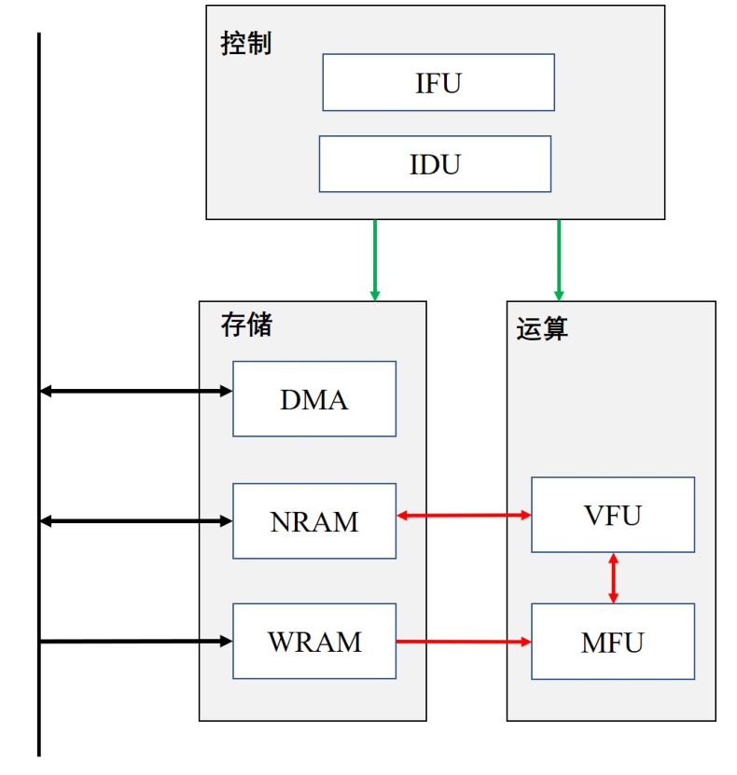
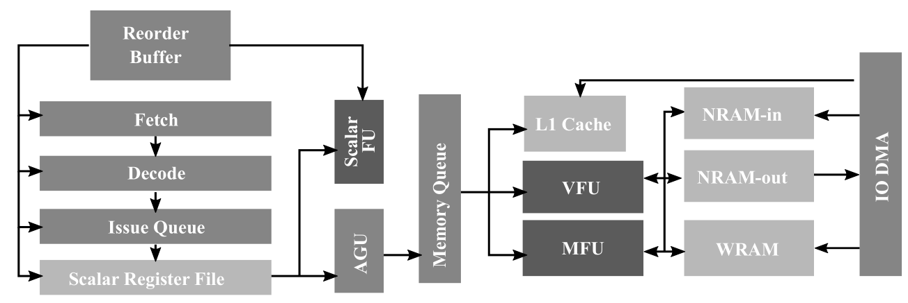
Cambricon AI Accelerator DLP-S
DLP-S
Control Module
Compute Unit
SRAM Unit

Slide 139
Where Are We?

Slide 140
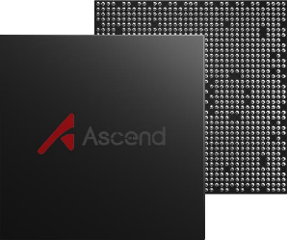

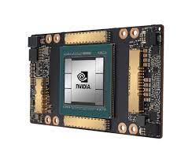
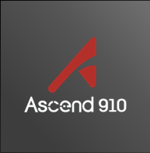
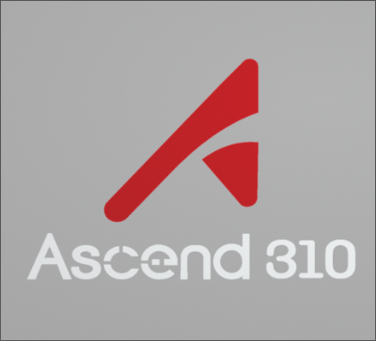

AI Architecture
Parallel
Training
Hybrid parallel
Data parallel
Model parallel
Pipeline parallel
模型训练和推理框架
AI Framework
MindSpore
TensorFlow
PyTorch
PaddlePaddle
…
计算加速库、芯片算子库和高度自动化的算子开发工具
AI Runtime
CANN*
CUDA*
Compute Architecture for Neural Network
Compute Unified Device Architecture
AI IP和芯片
AI Chip
Ascend
Notes:
全流程服务，分层API和预集成方案
降低核心代码量20%,效率提升50%以上
应对算子多样性，开发效率提升3倍

Slide 141
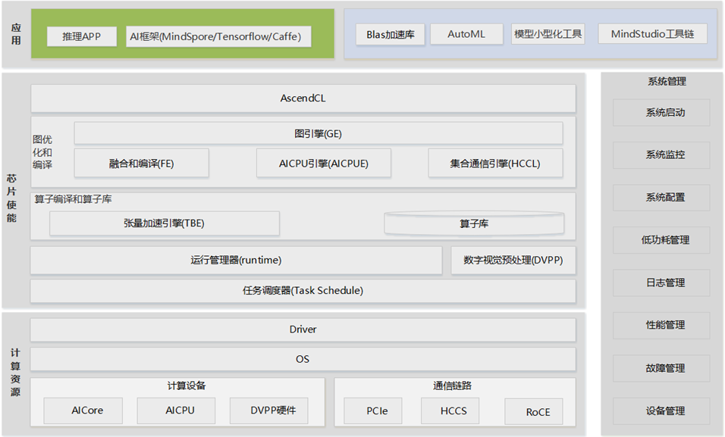
Compute Architecture for Neural Network (CANN)
Notes:
全流程服务，分层API和预集成方案
降低核心代码量20%,效率提升50%以上
应对算子多样性，开发效率提升3倍

Slide 142
CANN算子开发方式比较
参数 | TBE DSL方式 | TIK方式 | AI CPU方式
语言 | Python | Python | C++
计算单元 | AI Core | AI Core | AI CPU
运用场景 | 常用于各种算术逻辑简单向量运算，或内置支持的矩阵运算及池化运算 | 适用各类算子的开发，对于无法通过lambda表达描述的复杂计算场景也有很好的支持，例如排序类操作 | 某些场景下，无法通过AI Core实现的自定义算子，或者需要临时快速打通网络的场景下使用
入门难度 | 较低 | 较高 | 中等
适用人群 | 入门用户，需要了解NN、TBE DSL相关知识 | 高级用户，需要了解NN，深入理解昇腾AI处理器架构、指令集、数据搬运等相关知识 | 具备C++程序开发能力，对机器学习、深度学习、AI CPU开发流程有一定的了解
特点 | TBE DSL接口已高度封装，用户仅需要使用DSL接口完成计算过程的表达，后续的Schedule创建、优化及编译都可通过已有接口一键式完成 | 入门难度高，程序员直接使用TIK提供的API完成计算过程的描述及Schedule过程，需要手工控制数据搬运的参数和Schedule。用户无须关注Buffer地址的分配及数据同步处理，由TIK工具进行管理 | 开发的流程和DSL都是类似的， 不需要了解AI Core的内部架构设计，入门较快
不足 | 某些场景下性能可能较低，复杂算子逻辑无法支持表达 | 需要开发者手工控制数据搬运的参数和Schedule过程。 | 无封装的计算接口，计算过程相对繁琐，另外AI CPU性能较低。

Slide 143
初阶图优化-CSE
+
*
*
+
+
B
C
D
B
C
E
+
w
*
*
+
w
B
C
D
E
Notes:
CSE（Common-Subexpression Elimination），公共子表达式消除。
简单而言就是将相同输入的表达式进行消除，复用计算结果。

Slide 144
图优化-算子融合（Intuition）
算子特性：
每个算子都从内存读数
Data
计算完成放回内存
Conv2D
Data
BatchNorm
算子执行的访存特性：
ConvD：顺序写
BatchNorm：顺序读写
ReLU：顺序读写
Conv2D_BatchNorm_Relu
Relu
Notes:
Reducing high-cost operations

Slide 145
Where Are We?

Slide 146
MindSpore逻辑架构
Model Zoo
MindSpore Extend
GNN/深度概率编程/强化学习/微分方程
自动并行：整图切分，感知集群拓扑，实现通信开销最小，融合数据并行与模型并行；
二阶优化：利用二阶计算修正梯度更新方向，找到训练梯度最优下降路径，从而加速训练收敛过程；
动静态图结合：统一自动微分引擎支持动静态图，一行代码完成模式切换，兼顾模型开发和执行效率；
AI+科学计算，场景应用创新，拓展MindSpore的边界
Mind
Armour
MindData
MindExpression
仓颉
前端
Mind
Insight
密态AI
网络调试
可信AI
MindCompiler
精度调优
类型推导
自动微分
自动并行
二阶优化
量化/剪枝/….
内存优化
图算融合
流水线执行
性能调优
MindIR
硬件相关优化
MindAKG(算子自动生成)
MindRT
MindRT(分布式DAG并行执行)
MindRT Lite/Micro
CANN昇腾
CUDA
Eigen
Android
iOS

Slide 147
关键技术4：AI+科学计算
科学计算近况：
科学计算核心问题是微分方程求解，算力消耗巨大，大规模求解器垄断历年戈登贝尔奖，近年来结合AI方法成为趋势。
传统数值方法
高维微分方程求解，计算量大
边界条件复杂，求解不稳定
AI方法求解
非线性拟合，无需解高维方程
神经网络模拟，不需要处理边界条件
业界AI+科学计算现状：
TF：众筹方式构建AI求解模型，典型应用领域取得突破；面向DNN设计的自动微分，计算高阶微分时效率低下；
Nvidia：支持高精度计算；构筑cuBLAS、cuFFT等基础数学库；上层框架依赖TensorFlow，继承TF缺点
Notes:
科学计算才是AI应用的蓝海。。。

Slide 148

One Iteration for a Layer
One iteration:
Backward pass:
Its compute is ~2x of forward
requires activations computed during the fwd pass
W
X
Y
1, Forward Pass:
×
=
2, Backward Pass:
weight gradients
dY
_{X} T
dW
×
=
_{W} T
Read After Write (RAW) Dependency Regarding the Model x
dY
dX
2, Backward Pass:
activation gradients
× =
W
dW
W
3, Weight update:
+
+ … =
[Micikevicius, Fundamentals of Scaling Out DL Training, 2020]

Slide 149
Why Distributed Training?
Challenge from Model Side: Larger models
Language models: in the past 2 years grew from 340M (BERT-large) to 175B (GPT-3) parameters
Recommender models: largest ones are reaching O(1B) parameters
Vision models: deeper and wider Resnets and ResNeXTs
Challenge from Dataset Side: Larger datasets
Recommender data (user behavior): terabytes to petabytes
Image data: 1B Instagram dataset, JFT (300M images)
Challenge from System Side:
The memory size of a single accelerator, e.g., GPU, is 40GB.

Slide 150
Parallelism Taxonomy
Parallel Training
Data Parallel
Model Parallel
Intra Layer
Inter Layer/
Pipeline
[Micikevicius, Fundamentals of Scaling Out DL Training, 2020]

Slide 151
Data Parallel: Forward Pass
Whole Model
Partial dataset
W
X
Y
Worker 0:
×
=
Forward pass:
Computes output activations for its portion of minibatch
No communication is needed
Worker 1:
×
=
Worker 2:
×
=
X : input activations
W : model
Y : output activations
Worker 3:
×
=
[Micikevicius, Fundamentals of Scaling Out DL Training, 2020]

Slide 152

Data Parallel Training: Weight Update
Weight update:
1, Each of N workers accumulates gradients:
Summing 1/N gradients collected from (N – 1) peers
2, Each worker updates its model:
Each worker updates its copy of the model with combined gradients from all 4 workers
Worker a
Worker b
(a+b+c+d)/4
Worker d
Worker c
[Micikevicius, Fundamentals of Scaling Out DL Training, 2020]

Slide 153
Data Parallel: Challenges
Strong scaling (increase the number of workers, keep minibatch size constant)
Certain layers require minimum minibatch sizes to properly operate
Example: batch normalization (BN) generally requires 16+ samples
Maybe lower GPU utilization
Weak scaling (increase the number of workers, increase minibatch size)
Training networks with large minibatches requires hyper-parameter adjustment
Learning rate schedule, BN decay, …
Example: R50 (SGD up to bs=16K, LARS above 16K, …)
Often increase the amount of work required to reach the same model accuracy
[Micikevicius, Fundamentals of Scaling Out DL Training, 2020]

Slide 154
Parallelism Taxonomy
Parallel Training
Data Parallel
Model Parallel
Intra Layer
Inter Layer/
Pipeline
[Micikevicius, Fundamentals of Scaling Out DL Training, 2020]

Slide 155
Model Parallel Training
Worker 0
Worker 1
Worker 2
Inter-layer Parallel (aka Pipeline Parallel):
A worker is responsible for its portion of the layers
Layer 1
Layer 2
Layer 3
Layer 4
Layer 5
Worker 0
Intra-layer Parallel
A worker is responsible for its portion of each layer
Worker 1
Layer 1
Layer 2
Layer 3
Layer 4
Layer 5
Worker 2
[Micikevicius, Fundamentals of Scaling Out DL Training, 2020]

Slide 156
Pipeline Parallel Training
Time
Layer 1 Layer 2 | Worker | 0
Layer 3 Layer 4 | Worker | 1
Layer 5 | Worker | 2
Forward
Loss
Backward
[Micikevicius, Fundamentals of Scaling Out DL Training, 2020]

Slide 157
Pipeline Parallel Training
Time
Layer 1 Layer 2 | Worker | 0
Layer 3 Layer 4 | Worker | 1
Layer 5 | Worker | 2
Forward
Loss
Backward
[Micikevicius, Fundamentals of Scaling Out DL Training, 2020]

Slide 158

Pipeline Parallel Training
Time
Layer 1 Layer 2 | Worker | 0
Layer 3 Layer 4 | Worker | 1
Layer 5 | Worker | 2
Forward
Loss
Backward
[Micikevicius, Fundamentals of Scaling Out DL Training, 2020]

Slide 159


Pipeline Parallel Training
Time
Layer 1 Layer 2 | Worker | 0
Layer 3 Layer 4 | Worker | 1
Layer 5 | Worker | 2
Forward
Loss
Backward
[Micikevicius, Fundamentals of Scaling Out DL Training, 2020]

Slide 160


Pipeline Parallel Training
Time
Layer 1 Layer 2 | Worker | 0
Layer 3 Layer 4 | Worker | 1
Layer 5 | Worker | 2
Forward
Loss
Backward
[Micikevicius, Fundamentals of Scaling Out DL Training, 2020]

Slide 161


Pipeline Parallel Training
Time
Layer 1 Layer 2 | Worker | 0
Layer 3 Layer 4 | Worker | 1
Layer 5 | Worker | 2
Forward
Loss
Backward
[Micikevicius, Fundamentals of Scaling Out DL Training, 2020]

Slide 162
Pipeline Parallel Training
Time
Layer 1 Layer 2 | Worker | 0
Layer 3 Layer 4 | Worker | 1
Layer 5 | Worker | 2
Forward
Loss
Backward
Idle bubbles:
67%: 12/18 step-slots
For N workers:
(N – 1)/N idle slots
[Micikevicius, Fundamentals of Scaling Out DL Training, 2020]
Notes:
N: number of workers, devices.

Slide 163






Pipeline Parallel Training: GPipe
Key Idea: Subminibatches
Layer 1 Layer 2 | Worker | 0
Layer 3 Layer 4 | Worker | 1
Layer 5 | Worker | 2
Forward
Loss
Backward
2 subminibatches
2x more steps
Each step is ½ compute
Idle bubbles: 50%
12/24 steps-slots
[Micikevicius, Fundamentals of Scaling Out DL Training, 2020]

Slide 164
Pipeline Parallel Training: GPipe
Layer 1 Layer 2 | Worker | 0
Layer 3 Layer 4 | Worker | 1
Layer 5 | Worker | 2
Forward
Loss
Backward
N workers, K subminibatches:
As N grows:
2(N + K – 1) steps for fwd/bwd
Total step-slots: 2N(N + K – 1)
Idle step-slots: 2N(N – 1)
Fraction of idle slots: (N – 1)/(N + K – 1)
K = N → 50% idle slots
K = 4N → 20% idle slots
[Micikevicius, Fundamentals of Scaling Out DL Training, 2020]

Slide 165
Pipeline Parallel: Communication
A worker communicates with its 2 neighbors
1D mesh topology
1D torus when interleaving layers
Communication in each step of the fwd and bwd pass
Activations in fwd, activation gradients in bwd
Overlap communication with computation
Very hard
[Micikevicius, Fundamentals of Scaling Out DL Training, 2020]

Slide 166
Pipeline Parallel: Challenges
Load balancing workload across workers is difficult
Different layers of a network can take different amounts of time
Leads to even busy slots for other workers idling for portions of time
Lots of computation to hide communication
Idle slots reduce scaling efficiency
Many subminibatches help with this, but run into the same problems as strong-scaling of data-parallel.
[Micikevicius, Fundamentals of Scaling Out DL Training, 2020]

Slide 167
Outline
Why Distributed Training？
Data Parallelism
Model Parallelism
Pipeline
Intra-layer
Communication Pattern Review
Summary

Slide 168
Intra-layer Parallel
Worker 0
Worker 1
Layer 1
Layer 2
Layer 3
Layer 4
Layer 5
Worker 2
Partition a given layer’s weights among the workers
Addresses some of the Pipeline Parallel challenges
Idle slots, load imbalance
Two variants:
Row-wise partitioning
Column-wise partitioning
Row-wise partitioning:
Column-wise partitioning:
×
×
[Micikevicius, Fundamentals of Scaling Out DL Training, 2020]

Slide 169
Row-wise Partitioning: Allgather between Layers
W
X
Y
Worker 0
× =
× =
Worker 1
× =
× =
Worker 2
× =
× =
Layer K fwd
Fwd communication: Allgather
Layer (K + 1) fwd
Each worker:
W: Has a portion of weight rows
X: All of input activations X
Y: Computes a portion of output activations
[Micikevicius, Fundamentals of Scaling Out DL Training, 2020]

Slide 170










Column-wise Partitioning: ReduceScatter between Layers
W
X
Y
+
Worker 0
× =
× =
Worker 1
× =
+
× =
Worker 2
× =
× =
+
Layer K fwd
Fwd communication: ReduceScatter
Layer (K + 1) fwd
Each worker:
W: Has a portion of weight rows
X: All of input activations X
Y: Computes a portion of output activations
[Micikevicius, Fundamentals of Scaling Out DL Training, 2020]
Notes:
Fwd communication:
Reduce_scatter: each worker needs partial activations at next layer

Slide 171









Reducing Synchronization By Alternating Partitioning
Row-wise partitioning Column-wise partitioning
Worker 0
× =
× =
Worker 1
× =
× =
Worker 2
× =
× =
W
W
Layer K fwd
Layer (K + 1) fwd
Note: no communication is needed for two layers
Worker i produces output, which is its input for the next layer
[Micikevicius, Fundamentals of Scaling Out DL Training, 2020]
Notes:
Fwd communication:
Reduce_scatter: each worker needs partial activations at next layer

Slide 172
Reducing Synchronization By Alternating Partitioning
Row-wise partitioning Column-wise partitioning
Worker 0
× =
× =
Worker 1
× =
× =
+Next two layers?
Worker 2
× =
× =
W
W
Layer K fwd
Layer (K + 1) fwd
Note: no communication is needed for two layers
Worker i produces output, which is its input for the next layer
[Micikevicius, Fundamentals of Scaling Out DL Training, 2020]
Notes:
Fwd communication:
Reduce_scatter: each worker needs partial activations at next layer

Slide 173
Reducing Synchronization By Alternating Partitioning
Row-wise partitioning Column-wise partitioning Row-wise partitioning
+
Worker 0
× =
× =
× =
Worker 1
× =
× =
+
× =
Worker 2
× =
× =
× =
+
Layer K fwd
Layer (K + 1) fwd
Communication: Allreduce
Layer (K + 2) fwd
[Micikevicius, Fundamentals of Scaling Out DL Training, 2020]
Notes:
Fwd communication:
Reduce_scatter: each worker needs partial activations at next layer

Slide 174
Communication Pattern Summary
Data Parallel:
Allreduce of weights
Can be overlapped with computation
Pipeline Parallel:
Point-wise communication of activations and activation gradients
Hard to overlap with computation
Hard to load-balance
Intra-layer Parallel:
Allgather, Reduce_scatter of activations and activation gradients
Allreduce if row-wise and col-wise partitioning is alternated
Hard to overlap with computation

Slide 175
Grading Policy:
5%: pop quiz + checking
35%: 4-5 Lab assignments
lab grade = report (40%) + check(60%)
5-10%: Bonus
60%: Final exam
(close-book test with one A4 memo)
Understand the key idea of each component
Final grade = Min(Final exam + pop quiz + Labs, 99)
40%

Slide 176
Lab assignments 35%
Objectives
Implement a pipelined CPU with at least RISCV instructions + SIMD instructions via Verilog in Vivado (15%)
GPU Programming (10%)
AI Chip Programming (10%)
How
Do the lab by yourself and submit lab report and code to website.
Do 3 lab assignments gradually, examine results each time
TAs will ask questions regarding your lab reports and your code.
Grading
Lab1-3: 15%, 10%, 10% + Bonus

